Slide 1
PART 5 Working with Test Documentation

Slide 2
Agenda

Slide 3
I. Planning Your Test Effort
1. The Goal of Test Planning
2. Test Planning Topics

Slide 4
I. Planning Your Test Effort
1. The Goal of Test Planning
To prescribe the scope, approach, resources, and schedule of the testing activities. To identify the items being tested, the features to be tested, the testing tasks to be performed, the personnel responsible for each task, and the risks associated with the plan.
——IEEE Standard 8291998

Slide 5
I. Planning Your Test Effort
1. The Goal of Test Planning
NOTE:
The test plan is a by-product of the detailed planning process that's undertaken to create it. It's the planning process that matters, not the resulting document.
The ultimate goal of the test planning process is communicating (not recording) the software test team's intent, its expectations, and its understanding of the testing that's to be performed.

Slide 6
I. Planning Your Test Effort
2. Test Planning Topics
High-Level Expectations
People, Places, and Things
Definitions
Inter-Group Responsibilities
What Will and Won't Be Tested
Test Phases
Test Strategy
Resource Requirements
Tester Assignments
Test Schedule

Slide 7
I. Planning Your Test Effort
2. Test Planning Topics
Test Cases
Bug Reporting
Metrics and Statistics
Risks and Issues

Slide 8
I. Planning Your Test Effort
2. Test Planning Topics
High-Level Expectations
  What's the purpose of the test planning process and the software test plan?
  What product is being tested?
  What are the quality and reliability goals of the product?

Slide 9
I. Planning Your Test Effort
2. Test Planning Topics
People, Places, and Things

Slide 10
I. Planning Your Test Effort
2. Test Planning Topics
Definitions
  Bug
  Build
  Test release document (TRD)
  Alpha release
  Beta release
  Spec complete
  Feature complete
  Bug committee

Slide 11
I. Planning Your Test Effort
2. Test Planning Topics
Inter-Group Responsibilities

Slide 12
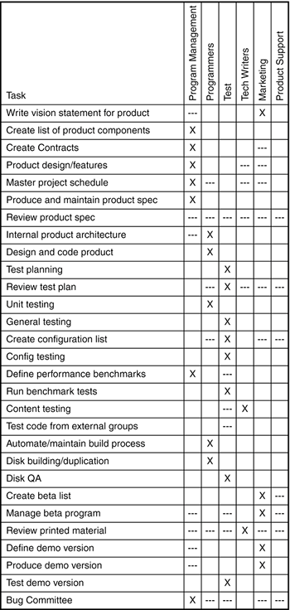

Slide 13
I. Planning Your Test Effort
2. Test Planning Topics
What Will and Won't Be Tested

Slide 14
I. Planning Your Test Effort
2. Test Planning Topics
Test Phases
NOTE:
Two very important concepts associated with the test phases are the entrance and exit criteria. The test team can't just walk in to work on Monday morning, look at the calendar and see that they're now in the next phase. Each phase must have criteria defined for it that objectively and absolutely declares if the phase is over and the next one has begun.

Slide 15
I. Planning Your Test Effort
2. Test Planning Topics
Test Strategy

Slide 16
I. Planning Your Test Effort
2. Test Planning Topics
Resource Requirements
  People
  Equipment
  Office and lab space
  Software
  Outsource companies
  Miscellaneous supplies

Slide 17
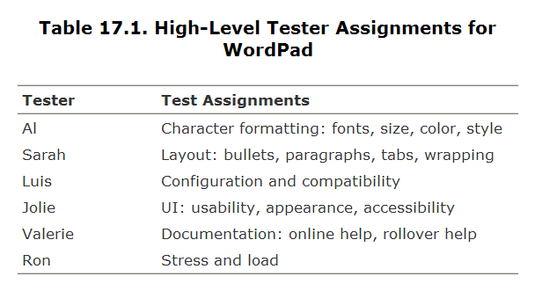
I. Planning Your Test Effort
2. Test Planning Topics
Tester Assignments

Slide 18
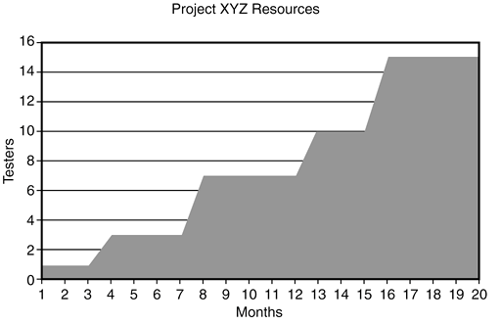
I. Planning Your Test Effort
2. Test Planning Topics
Test Schedule

Slide 19
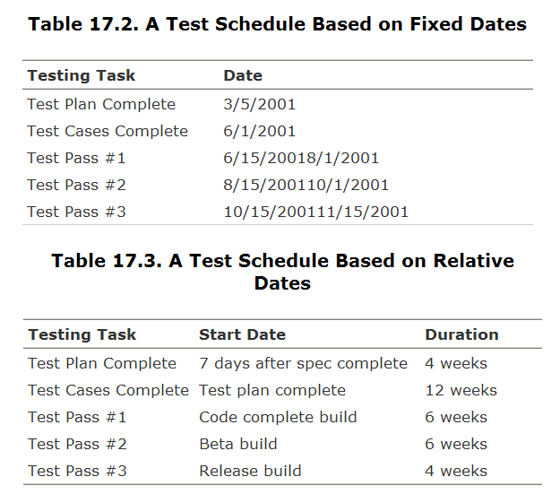

Slide 20
I. Planning Your Test Effort
2. Test Planning Topics
Test Cases

Slide 21
I. Planning Your Test Effort
2. Test Planning Topics
Bug Reporting

Slide 22
I. Planning Your Test Effort
2. Test Planning Topics
Metrics and Statistics
  Total bugs found daily over the course of the project
  List of bugs that still need to be fixed
  Current bugs ranked by how severe they are
  Total bugs found per tester
  Number of bugs found per software feature or area

Slide 23
I. Planning Your Test Effort
2. Test Planning Topics
Risks and Issues

Slide 24
I. Planning Your Test Effort
1. The Goal of Test Planning
2. Test Planning Topics

Slide 25
PART 5 Working with Test Documentation

Slide 26
Agenda

Slide 27
II. Writing and Tracking Test Cases
1. The Goals of Test Case Planning
2. Test Case Planning Overview
3. Test Case Organization and Tracking

Slide 28
II. Writing and Tracking Test Cases
The Goals of Test Case Planning
  Organization
  Repeatability
  Tracking
  Proof of testing (or not testing)
NOTE:
Don't confuse test case planning with the identification of test cases that you learned in Part II, "Testing Fundamentals." Those chapters taught you how to test and how to select test cases, similar to teaching a programmer how to program in a specific language. Test case planning is the next step up and is similar to a programmer learning how to perform high-level design and properly document his work.

Slide 29
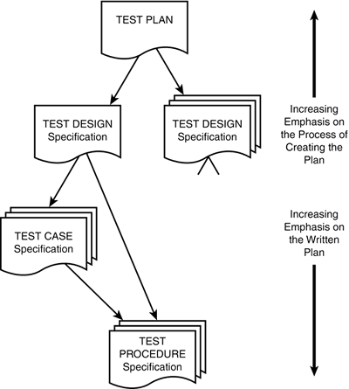
II. Writing and Tracking Test Cases
2. Test Case Planning Overview

Slide 30
II. Writing and Tracking Test Cases
2. Test Case Planning Overview
  Test Design
  Test Cases
  Test Procedures

Slide 31
II. Writing and Tracking Test Cases
2. Test Case Planning Overview
Test Design
IEEE 829 states that the test design specification "refines the test approach [defined in the test plan] and identifies the features to be covered by the design and its associated tests. It also identifies the test cases and test procedures, if any, required to accomplish the testing and specifies the feature pass/fail criteria."

Slide 32
II. Writing and Tracking Test Cases
2. Test Case Planning Overview
Test Design
  Identifiers
  Features to be tested
  Approach
  Test case identification
  Pass/fail criteria

Slide 33
II. Writing and Tracking Test Cases
2. Test Case Planning Overview
Test Case
IEEE 829 states that the test case specification "documents the actual values used for input along with the anticipated outputs. A test case also identifies any constraints on the test procedure resulting from use of that specific test case."

Slide 34
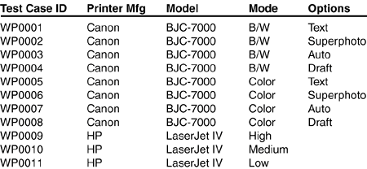
II. Writing and Tracking Test Cases
2. Test Case Planning Overview
Test Cases
  Identifiers
  Test item
  Input specification
  Output specification
  Environmental needs
  Special procedural requirements
  Intercase dependencies.

Slide 35
II. Writing and Tracking Test Cases
2. Test Case Planning Overview
Test Procedures
IEEE 829 states that the test procedure specification "identifies all the steps required to operate the system and exercise the specified test cases in order to implement the associated test design.“
  Identifier
  Purpose
  Special requirements
  Procedure steps

Slide 36
II. Writing and Tracking Test Cases
2. Test Case Planning Overview
Test Procedures steps
  Log
  Setup
  Start
  Procedure
  Measure
  Shut down
  Restart
  Stop
  Wrap up
  Contingencies

Slide 37
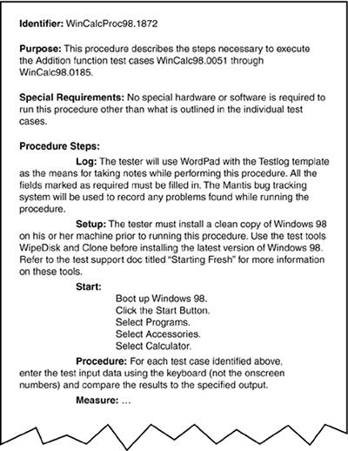

Slide 38
II. Writing and Tracking Test Cases
3. Test Case Organization and Tracking
In your head
Paper/documents
Spreadsheet
Custom database

Slide 39
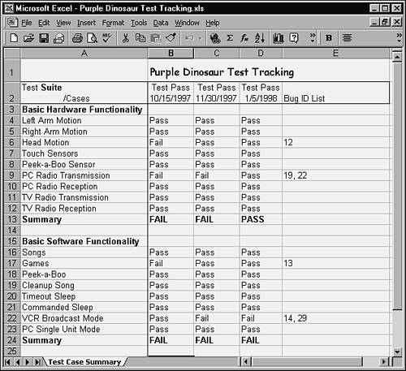

Slide 40
II. Writing and Tracking Test Cases
1. The Goals of Test Case Planning
2. Test Case Planning Overview
3. Test Case Organization and Tracking

